Slide 1
Matthew 25: 21 His lord said to him, ‘Well done, good and faithful servant; you were faithful over a few things, I will make you ruler over many things. Enter into the joy of your Lord.’

Slide 3
Luke 12: 48
From everyone who has been given much, much will be demanded; and from the one who has been entrusted with much, much more will be asked.

Slide 4
Faithfulness is very important.
P
O
W
E
R
RAYER life
VERCOME problems
ALK in God’s will
FFECTIVE in ministry
ELATIONSHIPS

Slide 5
How then can we be Faithful in an Unfaithful World??
Never Compromise The Word Of God
Be Sober and Be Vigilant
Ask The Holy Spirit To Empower You

Slide 6
I. NEVER COMPROMISE THE WORD OF GOD
Romans 1:21
" Because that when they knew God, they glorified Him not as God, neither was thankful, but became vain (useless) in their imaginations, and their foolish heart was darkened, professing themselves to be wise, they became fools. "

Slide 7
The basis of our faith is the BIBLE
If we twist the biblical truth, then our faith will become twisted too..
God gave us the bible to change us.. It’s not us who should change the bible.
The BIBLE is our guide/map to SALVATION.
Basic Instruction Before Leaving Earth.-b.i.b.l.e.

Slide 8
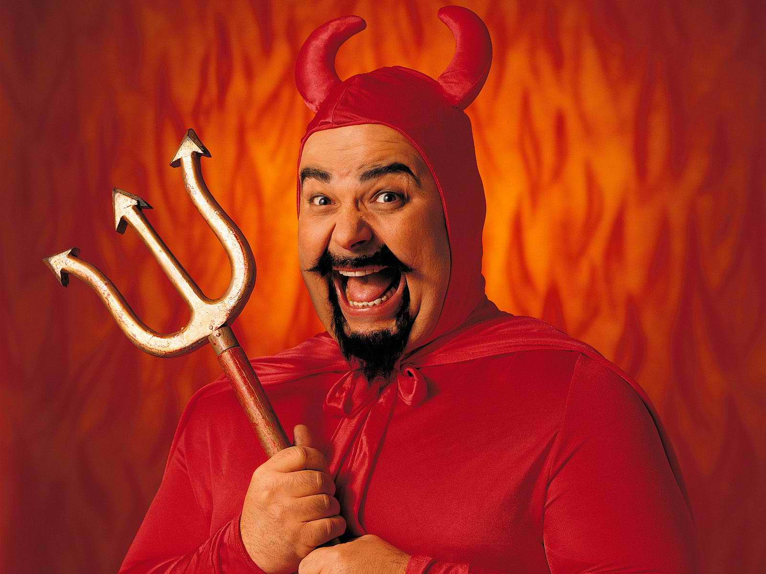
II. BE SOBER AND BE VIGILANT
1 Peter 5:8
“Be self-controlled and alert. Your enemy the devil prowls around like a roaring lion looking for someone to devour.”

Slide 9
We are Living in the Last Days
The signs are getting clearer and clearer as time passes by.
The Devil is very aggressive in deceiving the Children of God.
We must be on our guard and we should be prepared at all times.

Slide 10
III. ASK THE HOLY SPIRIT TO EMPOWER YOU
Acts 1:8
“But you will receive power
when the Holy Spirit comes on you;
and you will be my witnesses”

Slide 11
The Holy Spirit is the main source of Power
What good is a luxury car without a fuel? A new appliance if you have no power supply? Your phone without a battery?
Same with our Lives and Churches..
-our testimonies will have no impact
-our programs will not be effective
-our message will have no authority

Slide 12
(John 16:13a NLB) “When the Spirit of truth comes, he will guide you into all truth”
We are in a world full of lies..
The Holy Spirit will give us discerning in order for us to be able to distinguish truth from lies.

