Slide 1
Pre School Baccalaureate Message

Slide 2
Matthew 14:27-33

Slide 3
But Jesus immediately said to them: "Take courage! It is I. Don't be afraid."
"Lord, if it's you," Peter replied, "tell me to come to you on the water."
"Come," he said.
Then Peter got down out of the boat, walked on the water and came toward Jesus. But when he saw the wind, he was afraid and, beginning to sink, cried out, "Lord, save me!"

Slide 4
Immediately Jesus reached out his hand and caught him. "You of little faith," he said, "why did you doubt?"
And when they climbed into the boat, the wind died down. Then those who were in the boat worshiped him, saying, "Truly you are the Son of God."

Slide 5
Go the Distance

Slide 6
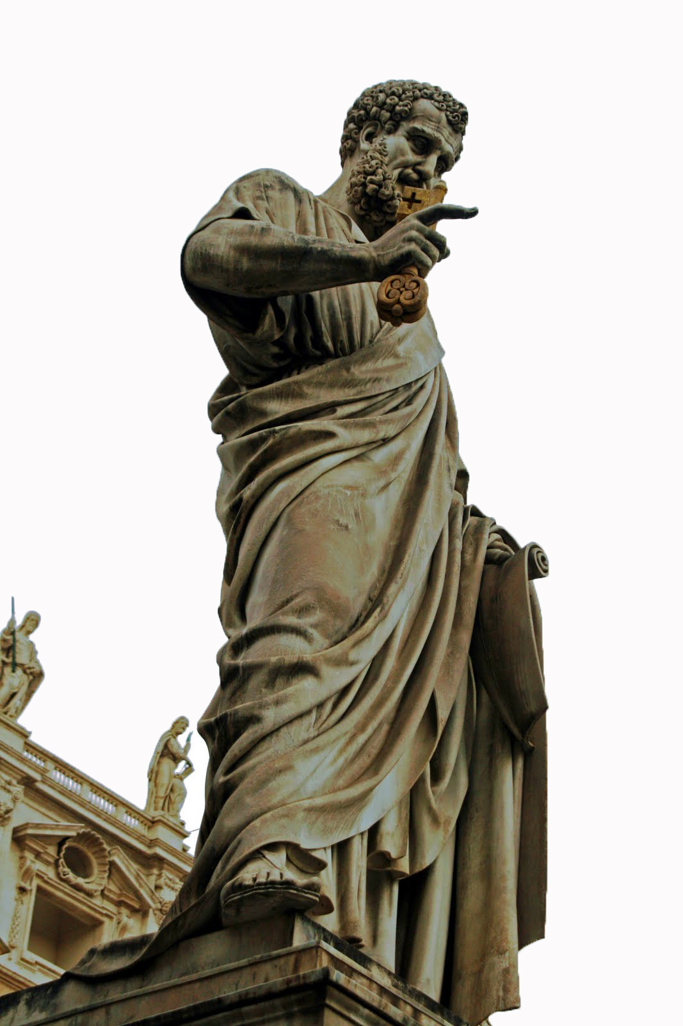
WHO IS PETER?
-very bold witness
- a great church leader
-a patriarch of faith

Slide 7
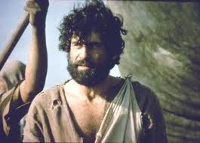
But BEFORE that. . .
He was just an ordinary fisherman
A coward
An infidel
A disloyal follower

Slide 8
He Did not Stop..
HELPING OTHERS
IMPROVING
MOVING FORWARD

