Slide 1
1 Peter 5:10 “And after you have suffered a little while, the God of all grace, who has called you to His eternal glory in Christ, will Himself restore, confirm, strengthen, and establish you.”

Slide 2
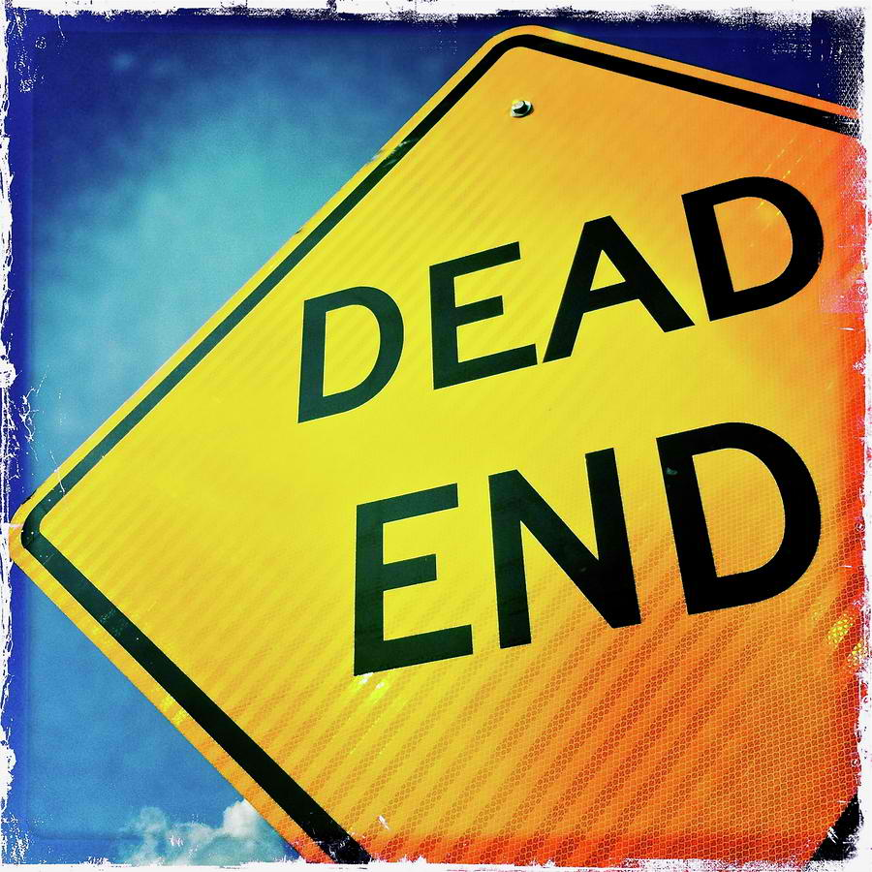

Slide 3
What do we mean by “dead end?”
Literally
-end of the road
-no way further
Figuratively
lacking opportunities especially for advancement
a situation in which further progress is impossible
problematic circumstance which has no solution

Slide 4
We sometimes reach “dead ends”..
Problems
Conflicts in Relationship
Financial Scarcity
Spiritual Crisis

Slide 5
We searched for solutions, but. . .

Slide 6
Paul also encountered the same problem..
2 Corinthians 4: 8,9
“We are hard PRESSED on every side, but not crushed; PERPLEXED, but not in despair; PERSECUTED, but not abandoned; STRUCK DOWN, but not destroyed.”

Slide 7
Lessons From Paul On How To Face “Dead Ends”. . .
P
P
P
raising God
ersevere hardships
aying attention to God’s voice

Slide 8
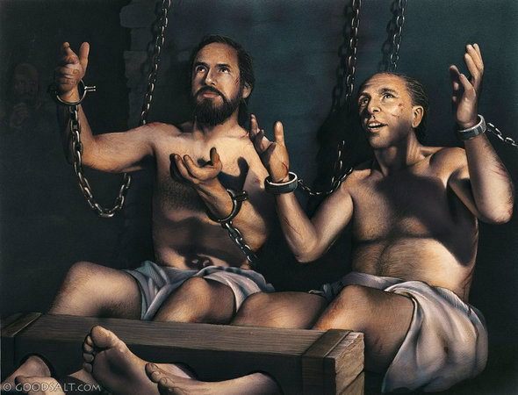
I. PRAISING GOD
Acts 16:25
“About midnight Paul and Silas
were praying and singing hymns
to God, and the other prisoners
were listening to them.”

Slide 9
“A person who kneels before God can stand in any problems..”
All bondages that bind us will be broken and destroyed..
-bondage of poverty
-bondage of immorality
-bondage of immaturity
-bondage of witchcraft/superstitious beliefs
-bondage of occultism
-all bondages of sin
Luke 1:37
“For nothing is impossible with God."

Slide 10
II. PERSEVERE HARDSHIPS
James 1: 4
“Let perseverance finish
its work so that you may
be mature and complete,
not lacking anything.”

Slide 11
Success is for those who deserve it.
“Winners never quit, and quitters never win.”
Its true that God allows trials so that we will grow spiritually.
BUT.. It does not mean that He doesn’t want us to prosper.
Jeremiah 29:11
For I know the plans I have for you,” declares the Lord, “plans to prosper you and not to harm you, plans to give you hope and a future.
WE ONLY HAVE TO PERSEVERE UNTIL WE FINISH DOING HIS WILL.

Slide 12
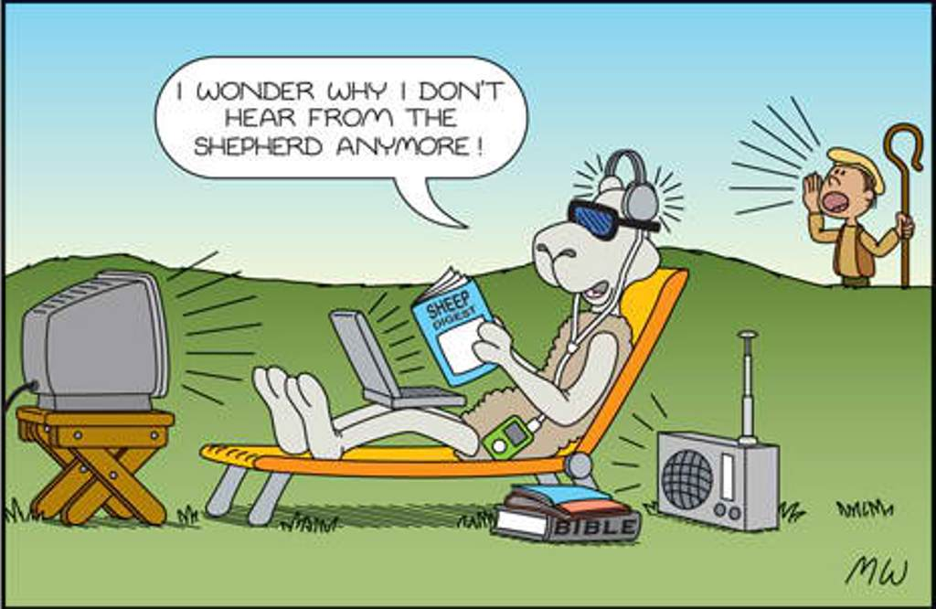
III. PAYING ATTENTION TO GOD’S VOICE
John 10:27
My sheep listen to my voice;
I know them, and they follow me.

Slide 13
A sheep gets lost when it refuses to follow the shepherd.
Same With Us If We Follow Our Own Will
Proverbs 16:25 “There is a way that seems right to a man, But its end is the way of death.”
We are spiritually blind because of sin and pride.. Our worldly desires drag us always to danger..
Christ is calling us..
-to avoid danger by following His words
Psalm 119:105
Your word is a lamp to my feet and a light for my path.

Slide 14
Are you facing a Dead End?
-just continue PRAISING God
-learn to PERSEVERE
-PAY ATTENTION to God’s instructions

