Slide 1
2 Chronicles 31:21 “And in every work that he began in the service of the house of God in the law and in the commandment, to seek his God, he did it with all his heart. So he prospered.”

Slide 3
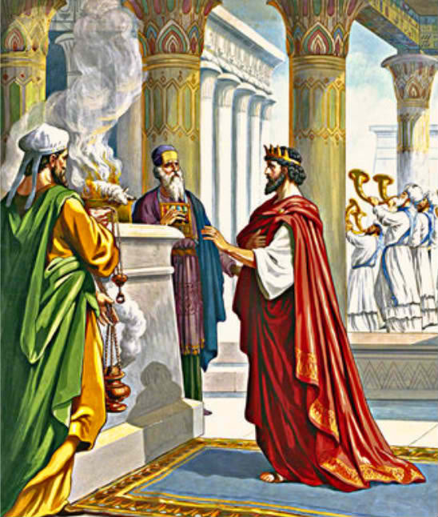
King Hezekiah
Son of King Ahaz
Prominent King
Godly King
Very Prayerful
God Prospered him

Slide 4
HOW CAN WE DEVELOP A PROSPEROUS LIFE?
W
W
W
aiting For You
alk In God’s Righteousness
illing To Share It To The Needy

Slide 5
I. Prosperity Is Waiting For Us
(1Cor 2:9) "No eye has seen, no ear has heard, and no mind has conceived what God has prepared for those who love Him.“
What kind of Prosperity?
Blessings beyond human conception..
It never runs out.. (satisfaction guaranteed)
However, it is exclusively accessible to God’s children

Slide 6
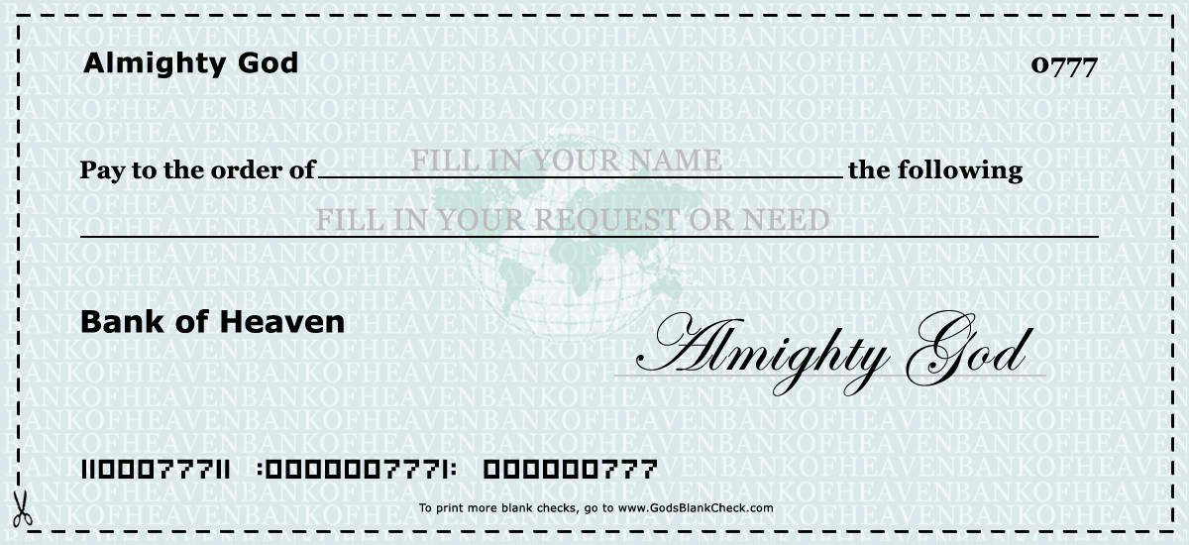
God’s Blank Check
Any Child of God
Any of Your Requests or Needs

Slide 7
II. Walk in God’s Righteousness
Proverbs 8:21
“. . .bestowing wealth on THOSE WHO LOVE ME and making their TREASURIES FULL.”
That is what being RIGHTEOUS means..
To LOVE God. . .
More than any temporal things this world can offer..
God promised that He will prosper us if we “Seek His Kingdom” first (Matt. 6: 33)

Slide 8
Prosperity Seems To Be A Never Ending Quest…
King Hezekiah Found The Key To Prosperity
Service In The House Of God
Obedience To The Will Of God
Seriousness In His Commitments To God
GOD WILL PROSPER US
Spiritually
Morally
Materially
In wisdom/ maturity
In our Relationships

Slide 9
III. Be Willing to Share it to the Needy
Hebrews 13:16
“Do not neglect to do good and to share what you have, for such sacrifices are pleasing to God.”
We must reflect the goodness of God by Helping others..
In SOCIOLOGY, helping others is one of the highest needs of an individual..

Slide 10
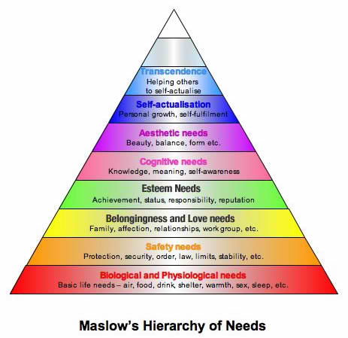

Slide 11
We should develop a “PROSPEROUS ATTITUDE”
Being ENVIOUS is not an attitude of a prosperous person
The Prosperous always Helps
Always reaching out to others so that others will experience self-actualization also..

Slide 12
Conclusion:
God prepared great blessings for us. . . We need also to be prepared to receive His blessings..
God will prosper us if we faithfully walk in His righteousness
We should develop a prosperous attitude by helping others

