Slide 1
Ezekiel 37:3 “And he said unto me, Son of man, can these bones live? And I answered, O Lord GOD, thou knowest.”

Slide 2
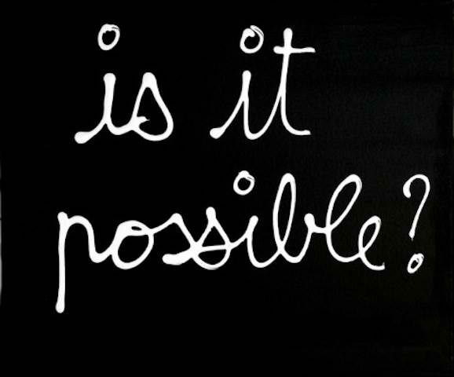

Slide 3
God is questioning Ezekiel..
Is it possible that these bones live?
-this is a TEST of Faith and Readiness of Ezekiel
-if he says “no” it would mean his infidelity to God
-“yes” will connote blind faith..
-Ezekiel wisely answered it…
“O Lord GOD, thou knowest.”
“ikaw lang ang nakakaalam”- meaning God is able to do anything, but there are things that He wont allow…
“Even the simplest test becomes impossible if WE DON’T HAVE God on our side .”

Slide 4
We encounter impossibilities..

Slide 5
goals
problems
circumstances
people

Slide 6
How should we deal with IMPOSSIBILITIES?
Believe
Believe
Believe
in God
in His Word
Until God Answers

Slide 7
I. Believe in God
Isaiah 41:10
“So do not fear, for I am with you; do not be dismayed, for I am your God. I will strengthen you and help you; I will uphold you with my righteous right hand.”
“You have to be bold facing the unknown because you have a known God.”- C.t. Boom
illustration: 2 men set on a journey together.
-an Atheist and a Christian
Notes:
2 MEN SET ON A JOURNEY. THE ONE IS A CHRISTIAN. THE OTHER IS A SKEPTIC. THE CHRISTIAN ALWAYS POINTS OUT THAT GOD IS GOOD.
THEY ARRIVED AT A VILLAGE. THEY LOOK FOR ROOM, BUT THERE’S NO ROOM AVAILABLE FOR THEM. THEY WENT OUT OF THE VILLAGE AND DECIDE TO TAKE SHELTER UNDER A TREE. THE SKEPTIC SARCASTICALLY JOKED,”YEAH, GOD IS GOOD INDEED. WE’RE NOW SLEEPING UNDER A TREE BECAUSE OF HIS GOODNESS.” THE CHRISTIAN ANSWERED, “ GOD IS GOOD AND HE KNOWS THIS IS THE BEST PLACE FOR US.”
WHEN MIDNIGHT CAME, THEY HEARD A HORRIBLE NOISE FROM THE DONKEY. AS THEY LIGHT THEIR TORCH, THEY SAW A LION DEVOURING AND KILLING THEIR DONKEY. AND SO THEY BOTH RAN. THE SKEPTIC ASKED THE CHRISTIAN,”HOW CAN YOUR GOOD GOD EXPLAIN THAT?”… HE ANSWERED,”THE LION WOULD HAVE EATEN US ALIVE IF ITS NOT BUSY EATING THE DONKEY… GOD IS GOOD!”
AS THEY WERE TALKING, A STRONG WIND BLOW OFF THEIR TORCH- THE LAST SOURCE OF THEIR COMFORT. THE SKEPTIC BUTT IN FASTLY, “MAYBE YOUR GOD WORKS DOUBLE TIME IN SHOWING HIS GOODNESS??”.. THE CHRISTIAN DID NOT ANSWER. HE JUST LISTEN TO THE SKEPTIC’S MURMURING UNTIL MORNING.
HUNGRY AS THEY ARE, THEY WENT BACK TO THE VILLAGE TO LOOK FOR FOOD. THEY SAW THAT THE VILLAGE WAS BURNED AND DESTOYED BY THE BANDITS.
THE CHRISTIAN COMMENTED,” NOW, EVERYTHING’S CLEAR… OUR TORCH DIED, SO THAT THE BANDITS WONT SEE US LAST NIGHT… GOD DID NOT ALLOW US TO STAY IN THE VILLAGE BECAUSE IT WILL BE BURNED AND DESTROYED… GOD IS REALLY GOOD!!”

Slide 8
II. Believe in God’s words
Psalm 119:105 “Your word is a lamp to my feet
and a light for my path.”
Seeking God’s guidance to ALL that we do; not just on things we’re not capable of doing.
“If you want to make God laugh, tell him about your plans.”-Woody Allen
We must entrust to Him everything
(Luke 1: 37) “For with God nothing is impossible.”

Slide 9
III. Believe until God answers
Romans 12:12
“Rejoice in hope,
be patient in tribulation,
be constant in prayer.”
How constant are we in our communication with God?
(1 Thessalonians 5:17)
“pray without ceasing;”
P
U
S
H
RAY
NTIL
OMETHING
APPENS
How many of you received dis-----→

Slide 10
APPLICATION:
we also have “bones/impossibilities” in our lives..
God asks us the same question that he asked Ezekiel…
“do you believe that these impossibilities have solution?”
-all we have to do is to entrust our lives and needs to our God
(Philippians 4:19)
"But my God shall supply all your need according to His riches in glory by Christ Jesus,"

Slide 11
if we Believe/Depend on God..
Impossible= “I’m Possible”
God Bless!

