Slide 1
1 Peter 5:6-7
Therefore humble yourselves under the mighty hand of God, that He may exalt you in due time, casting all your care upon Him, for He cares for you.

Slide 2
Matt 10:31
Do not fear therefore; you are of more value than many sparrows.

Slide 3
God's Care For Us!

Slide 4
Luke 12:24
Consider the ravens, for they neither sow nor reap, which have neither storehouse nor barn; and God feeds them. OF HOW MUCH MORE VALUE ARE YOU THAN THE BIRDS?
Unsa ang bili nato sa Ginoo?
Does He cares for us?
Does He cares about our sorrows?
Sa unsang mga pamaagi Niya kita gimahal??
Let’s take a trip before answering this

Slide 5
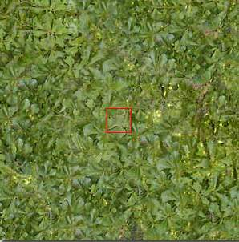
10⁰
^{1 meter}
Distansya sa mga dahon
3.28084 ft.

Slide 6
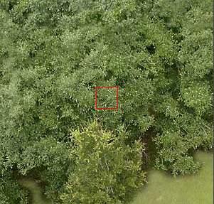
10¹
10 meters
Hinay-hinay nga trip pasaka
32.8 ft

Slide 7
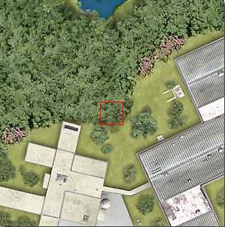
10²
100 meters
Gamay na jud and mga kakahoyan
103.28 ft

Slide 8
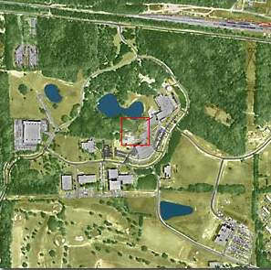
10³
1 km
Sa kini nga distansya pwede na kaambak..
Ang naay parachute
1 Meter is 0.001 Kilometer
Or 10,328 ft

Slide 9
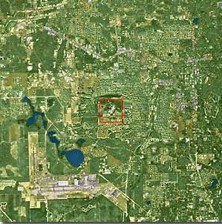
10⁴
10 km
Makita na ang porma sa city... Apan dili na clear ang mga balay ug mga tawo..
1 mile = 1.609344 kilometer
10 kilometer = 6.2 miles

Slide 10
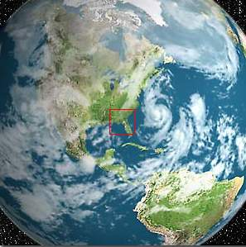
10⁷
10,000 km
EARTH
10000 kilometer = 6,213 miles

Slide 11
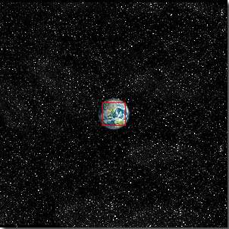
10⁸
100,000 km
The Earth starts looking small...
10000 kilometer = 62,137 miles

Slide 12
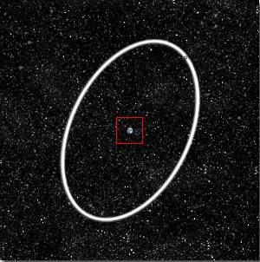
10⁹
1 Millión km
The Earth and the Moon’s órbit in white....
1,000,000 kilometer = 621,371 miles

Slide 13
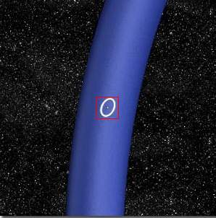
10¹⁰
10 Million km
Part of the Earth’s Orbit in blue
10,000,000 kilometer = 6,213,711 miles

Slide 14
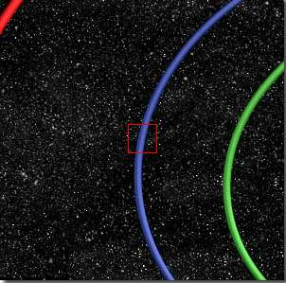
10¹¹
100 Million km
Órbits of: Venus and Earth...
100000000 kilometer = 62,137,119 miles

Slide 15
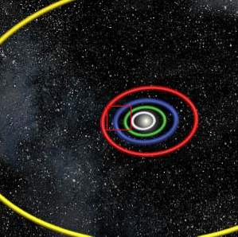
10¹²
1 Billión km
Órbits of: Mercury, Venus, Earth, Mars and Júpiter.
1,000,000,000 kilometer = 621,371,192 miles

Slide 16
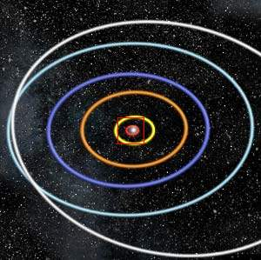
10¹³
10 Billion km
At this height of our trip, we could observe the Solar System and the orbits of the planets
10000000000 kilometer = 6,213,711,922miles

Slide 17
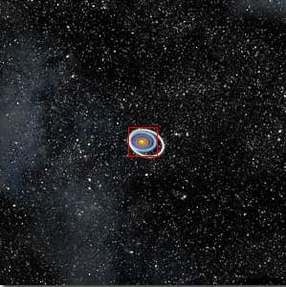
10¹⁴
100 Billion km
The Solar System starts looking small...
100,000,000,000 kilometer = 62,137,119,223 miles

Slide 18
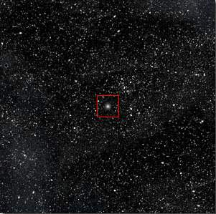
10¹⁵
1 Trillión km
The Sun now is a small star in the middle of thousands of stars...
1,000,000,000,000 kilometer = 621,371,192,237 miles

Slide 19
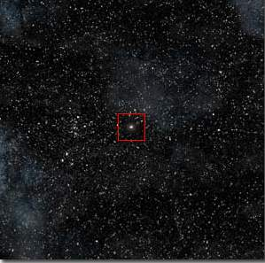
10¹⁶
1 light-year
At one light-year the little Sun star is very small
How Long is a Light-Year?
The light-year is a measure of distance, not time. It is the distance
that a beam of light, moving in a straight line, travels in one year. To
obtain an idea of the size of a light-year, take the circumference of the
earth (24,900 miles), lay it out in a straight line, multiply the
length of the line by 7.5 (the corresponding distance is one
light-second), then place 31.6 million similar lines end
to end. The resulting distance is almost
6 trillion (6,000,000,000,000) miles!

Slide 20
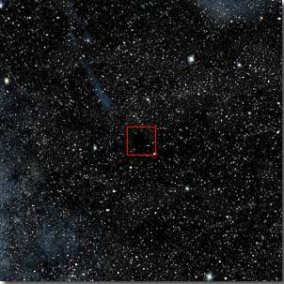
10¹⁷
10 light-years
Dili na jud makita ang solar system

Slide 21
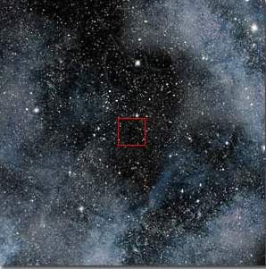
10¹⁸
100 light-years
“Nothing” Only stars and Nebulae...

Slide 22
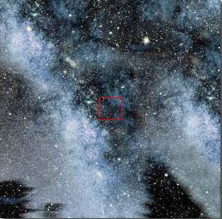
10¹⁹
1,000 light-years
At this distance we are travelling in the Via-Láctea (Milky Way), our galaxy.

Slide 23
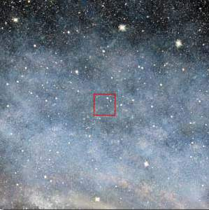
10²⁰
10,000 light-years
We continue our travel inside the Via-Láctea (Milky Way)

Slide 24
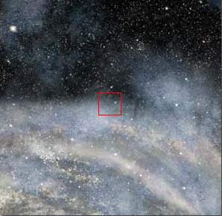
10²¹
100,000 light-years
We begin reaching the periphery of the Via-Láctea (Milky Way)

Slide 25
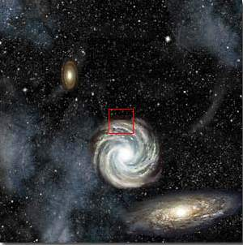
10²²
1 Millión light-years
At this tremendous distance we can see the entire Via-Láctea (Milky Way) & other galáxies as well ...

Slide 26
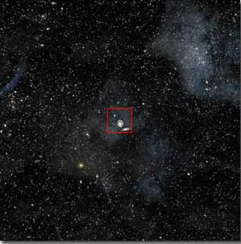
10²³ - 10 Million light-years
From this distance, all the galaxies look small with immense empty spaces in between. The same laws are ruling all bodies of the Universe. We could continue traveling upwards with our imagination, but now let’s return home quickly

Slide 27
10²²

Slide 28
10²¹

Slide 29
10²⁰

Slide 30
10¹⁹

Slide 31
10¹⁸

Slide 32
10¹⁷

Slide 33
10¹⁶

Slide 34
10¹⁵

Slide 35
10¹⁴

Slide 36
10¹³

Slide 37
10¹²

Slide 38
10¹¹

Slide 39
10¹⁰

Slide 40
10⁹

Slide 41
10⁸

Slide 42
10⁷

Slide 43
10⁴

Slide 44
10³
Or... What do we represent in the Universe?

Slide 45
10²
In this trip “upwards” we went to the power of 23 of 10

Slide 46
10¹
Now we are going to dig inside of matter in a reverse (inverse) trip...

Slide 47
10⁰
We arrive at our starting point. We could touch it with our hands ...

Slide 48
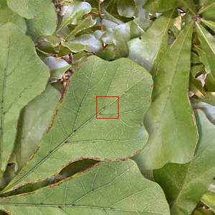
10⁻¹
10 Centímeters
Getting closer at 10 cm ...We can delineate the leaves.

Slide 49
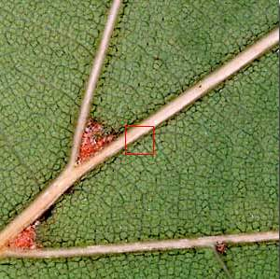
10⁻²
1 Centímeter
At this distance it is possible to observe the structure of the leaf.

Slide 50
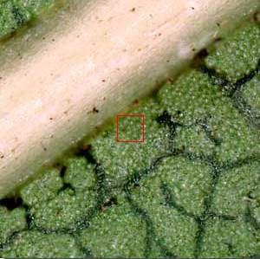
10⁻³
1 Millímeter
The cellular structures begin to show...

Slide 51
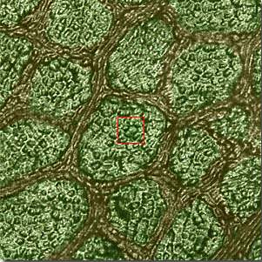
10⁻⁴
100 microns
The cells can be delineated. You can see the union between them.

Slide 52
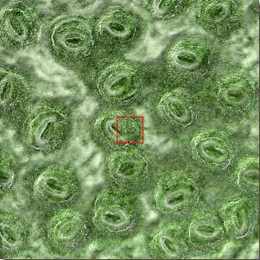
10⁻⁵
10 microns
Starting our trip inside the cell ...

Slide 53
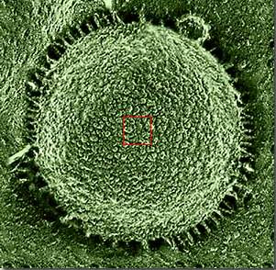
10⁻⁶
1 micrón
The nucleus of the cell is visible.

Slide 54
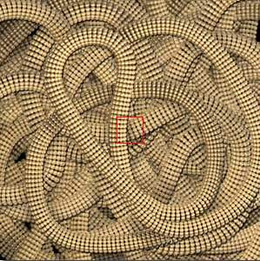
10⁻⁷
100 Nanometers
Again we changed the measuring unit to adapt to the miniscule size. You can see the chromosomes.

Slide 55
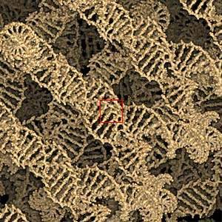
10⁻⁸
10 Nanometers
In this micro universe the DNA chain is visible.

Slide 56
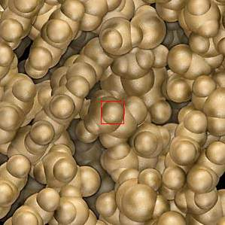
10⁻⁹
1 Nanometer
...the chromosóme blocks can be observed.

Slide 57
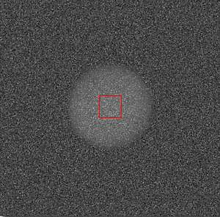
10⁻¹⁰
1 Angstrom
It appears like clouds of electrons... These are carbon átoms that formed our world. You should notice the resemblance of the micro cosmos with the macro cosmos ...

Slide 58
10⁻¹¹
10 Picometers
In this miniature world we could observe the electrons orbiting the atoms.

Slide 59
10⁻¹²
1 Picómeter
An immense empty space between the nucleus and the electron orbits...

Slide 60
10⁻¹³
100 Femtómeters
At this incredible and minuscule size we could observe the nucleus of the atom.

Slide 61
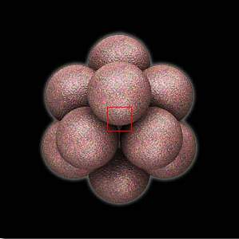
10⁻¹⁴
10 Femtómeters
Now we could observe the nucleus of the carbon atom

Slide 62
10⁻¹⁵
1 Femtómeter
Here we are in the field of the scientific imagination, face to face with a proton.

Slide 63
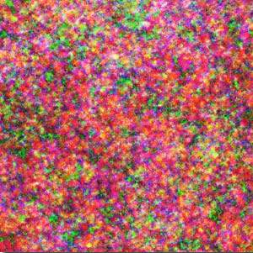
10⁻¹⁶
100 Attómeters
Examine the ‘quark’ partícules
There is nowhere further to go... We are at the limits of current scientific knowledge . Imagine, our Great Creator created a vast Universe.. Its vastness is simply beyond our imaginations...
God never fails to focus its attention to the smallest details that builds this world we know of...

Slide 64
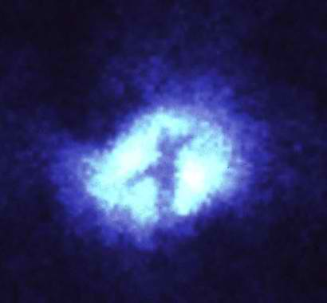
This image of the core of the nearby spiral galaxy M51, taken with the Wide Field Planetary camera (in PC mode) on the NASA/ESA Hubble Space Telescope, shows a striking , dark "X" silhouetted across the galaxy's nucleus.
Notes:
The "X" is due to absorption by dust and marks the exact position of a black hole which may have a mass equivalent to one-million stars like the sun. The darkest bar may be an edge-on dust ring which is 100 light-years in diameter. The edge-on torus not only hides the black hole and accretion disk from being viewed directly from earth, but also determines the axis of a jet of high-speed plasma and confines radiation from the accretion disk to a pair of oppositely directed cones of light, which ionize gas caught in their beam. The second bar of the "X" could be a second disk seen edge on, or possibly rotating gas and dust in MS1 intersecting with the jets and ionization cones.
The size of the image is 1100 light-years.

Slide 65
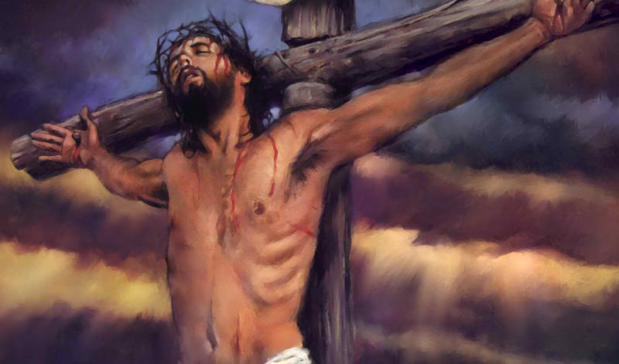
The “X” or the “Cross” structure reminds us that the God of the Universe died for you and me… isn’t is enough to show that He really cares for us??
Notes:
The "X" is due to absorption by dust and marks the exact position of a black hole which may have a mass equivalent to one-million stars like the sun. The darkest bar may be an edge-on dust ring which is 100 light-years in diameter. The edge-on torus not only hides the black hole and accretion disk from being viewed directly from earth, but also determines the axis of a jet of high-speed plasma and confines radiation from the accretion disk to a pair of oppositely directed cones of light, which ionize gas caught in their beam. The second bar of the "X" could be a second disk seen edge on, or possibly rotating gas and dust in MS1 intersecting with the jets and ionization cones.
The size of the image is 1100 light-years.

Slide 66
God Cares For Us!
1 Peter 5:6-7
Therefore humble yourselves under the mighty hand of God, that He may exalt you in due time, 7 casting all your care upon Him, for He cares for you.
How?
By providing a way to redeem us!
Titus 2:13-14
looking for the blessed hope and glorious appearing of our great God and Savior Jesus Christ, 14 who gave Himself for us, that He might redeem us from every lawless deed and purify for Himself His own special people, zealous for good works.

Slide 67
God Cares For Us!
He gave us power over life’s struggles!
2 Cor 5:3-4
For we who are in this tent groan, being burdened, not because we want to be unclothed, but further clothed, that mortality may be swallowed up by life 6 So we are always confident, knowing that while we are at home in the body we are absent from the Lord. 7 For we walk by faith, not by sight. 8 We are confident, yes, well pleased rather to be absent from the body and to be present with the Lord.

Slide 68
God Cares For Us!
He gives us a reason to live by faith!
Gal 2:19-20
I have been crucified with Christ; it is no longer I who live, but Christ lives in me; and the life which I now live in the flesh I live by faith in the Son of God, who loved me and gave Himself for me.

Slide 69
God Care For Us!
He gives us hope for a life with him!
Eph 1:18-21
the eyes of your understanding being enlightened; that you may know what is the hope of His calling, what are the riches of the glory of His inheritance in the saints, and what is the exceeding greatness of His power toward us who believe, according to the working of His mighty power far above all principality and power and might and dominion, and every name that is named, not only in this age but also in that which is to come.

