Slide 1
Matthew 23:12 For whoever exalts himself will be humbled, and whoever humbles himself will be exalted.

Slide 2
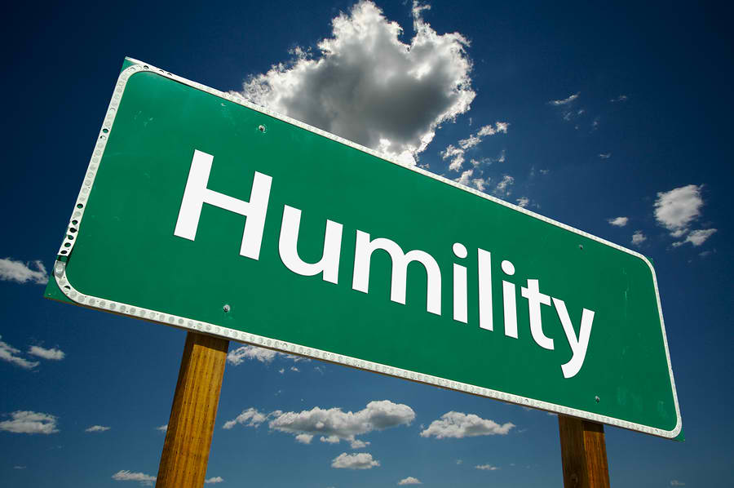

Slide 3
What is Humility?

Slide 4
It is not thinking of yourself highly than others…

Slide 5
It is a virtue that keeps one’s “feet on the ground”..

Slide 6
It is a constant effort of a person to put others first..

Slide 7
mitating Christ’s example
I
I
I
mproving spiritual life
nfluencing others

Slide 8
I. Imitating Christ example Matthew 16:24 “Then Jesus said to his disciples, "If anyone would come after me, he must deny himself and take up his cross and FOLLOW ME.” -NOT the Disciples’ example, but Christ’s. -Spiritual Leaders should only guide Christians to Christ. 1 Corinthians 11:1 “And you should imitate me, just as I imitate Christ.”

Slide 9
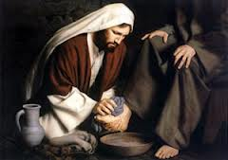
Matthew 20:27-28
..and whoever wants to be first must be your servant.. just as the Son of Man did not come to be served, but to serve, and to give his life as a ransom for many.

Slide 10
Just like Christ we should..
love one another..
be forgiving..
Selfless..
Be supportive to one another..

Slide 11
II. Improving spiritual life
James 5: 16
Therefore, confess your sins to one another and pray for one another, that you may be
. The prayer of a righteous person
has great power as it is working.
HEALED
HEALING or improvement.. How???
Confession- dili plastik.. Humble enough to accept his/her faults and easily submits to discipline

Slide 12
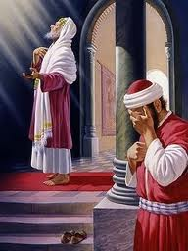
The opposite of Humility is Pride
Proverbs 16: 18
“Pride goeth before destruction, and an haughty spirit before a fall.”
Luke 18:14
"I tell you that this man, rather than the other, went home justified before God.

Slide 13
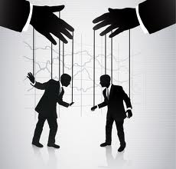
III. Influencing others
What is “Influencing?”
Not to manipulate or to control
The power to affect others

Slide 14
Proverbs 15:33
“The fear of the Lord is the instruction of wisdom; and before HONOR is humility.”
HONOR is our planting tool.
-its difficult to believe those people without honor -we can’t be a good influence to others if we do not “walk our talk?”

Slide 15
“As long as you are proud you cannot know God. A proud man is always looking down on thing and people: and, of course, as long as you are looking down you cannot see something that is above you.” ― C.S. Lewis

