Slide 1
Genesis 9:13 “I set My rainbow in the cloud, and it shall be for the sign of the covenant between Me and the earth”

Slide 2
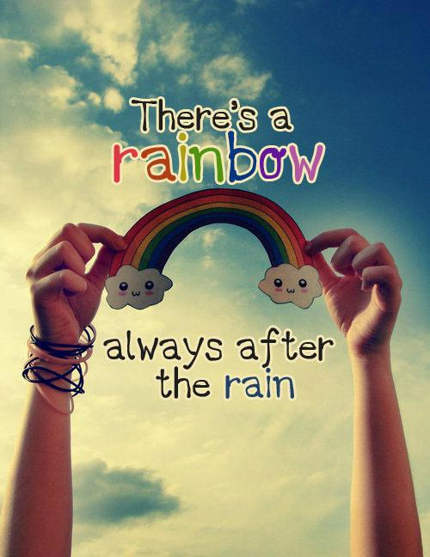

Slide 3
RAINBOW
Refraction of light through the water vapor
Colorful
Transition from rainy to sunny weather

Slide 4
For Christians, the Rainbow signifies
A New Life
God’s Promise
Reminder
End Of a Trial
Endure New Challenges

Slide 5
A NEW LIFE
2 Corinthians 5:17 Therefore, if anyone is in Christ, the new creation has come: The old has gone, the new is here!
In Noah’s time the people were very disobedient to God…
Sin and immoral acts were part of their norm
God preserved Noah and his family by sending flood
There are instances that “drizzle” cannot cleanse our wickedness so God send forth “storms”

Slide 6
GOD’S PROMISES
Romans 4:21
Fully convinced that God was able to do what he had promised.
The rainbow contains the promise of God that he wont send the deluge again
God had never broken one of His promises
What He says He will do
We should also trust His words
He protected ark during the storm.. He will also protect us…

Slide 7
REMINDER
Zephariah 3:17
The Lord your God is with you, He is mighty to save. He will take great delight in you, He will quiet you with his love, He will rejoice over you with singing.
After the storm, they sent a raven and later on a dove.. (only the dove came back)
Noah then built an altar where they could worship the Lord
The rainbow reminds Noah to worship the Lord
Why did they built an altar?
-thanking God should always be special.. We should give it our best always when we come before His presence..

Slide 8
END OF TRIAL
Matthew 11:28-30
“Come to me, all you who are weary and burdened, and I will give you rest.”
After the flood Noah and his family were tired
-physically
-emotionally
-spiritually
God gave them the “gift of rest”
When we are tired we should come to the Lord

Slide 9
ENDURE NEW CHALLENGES
Romans 5:3-4
More than that, we rejoice in our sufferings, knowing that suffering produces endurance, and endurance produces character, and character produces hope,
The challenge never stopped there
Noah “drowned in wine”
The rainbow signifies new challenges
Problems of the rainy days… and problems of the sunny days….
We should always be prepared

