Slide 1
2 Corinthians 8:11-12 Now finish the work, so that your eager willingness to do it may be matched by your completion of it, according to your means. For if the willingness is there, the gift is acceptable according to what one has, not according to what one does not have.

Slide 3
The Traffic Light is very helpful..
RED- STOP/ DANGER
AMBER/YELLOW- CAUTION/READY
GREEN- GO

Slide 4
LESSON FROM THE TRAFFIC LIGHT
STOP
READY
GO
living in danger
yourselves
to serve God

Slide 5
I. STOP living in Danger
PSALM 5:4-6
You are not a God who takes pleasure in evil; with you the wicked cannot dwell. The arrogant cannot stand in your presence; you hate all who do wrong. You DESTROY those who tell lies; bloodthirsty and deceitful men the LORD abhors.

Slide 6
SECURITY is not the absence of “danger”
-We can still experience security in the midst of troubles if God is with us (we have God’s Protection)
Psalm 23:4
Yea, though I walk through the valley of the shadow of death, I will fear no evil: for thou art with me; thy rod and thy staff they comfort me.
WHAT DOES DANGER MEANS??
Isa 66:15-16
"See, the Lord is coming with fire, and his chariots are like a whirlwind; he will bring down his anger with fury, and his rebuke with flames of fire.
DANGER is the absence of God in our lives.. DANGER also means making God angry by disobeying Him..

Slide 7
God’s Vineyard is not a Playground..
C.S. Lewis:
"God is the only comfort, He is also the supreme terror... He is our only possible ally, and we have made ourselves His enemies…”
Romans 1:18
The wrath of God is being revealed from heaven against all the godlessness and wickedness of people, who suppress the truth by their wickedness,
REPENT for your SINS.. For the WRATH of God is COMING…

Slide 8
II. READY ourselves
(Joshua 1:10, 11; 3:5)
Then Joshua commanded the officers of the people, saying, “Pass through the midst of the camp and command the people, saying, ‘PREPARE provisions for yourselves, for within three days you are to cross this Jordan, to go in to POSSESS the land which the Lord your God is GIVING YOU to possess it... CONSECRATE yourselves, for tomorrow the Lord will do WONDERS among you”’

Slide 9
Getting Ready for…
1. God’s Work
-put on the full armor of God
2. His Blessings
-how do we get ready for promotion?
-our attitude and character
3. Consecrating Of Ourselves
-(Psalm 139:23-24)
Search me, God, and know my HEART; test me and know my anxious THOUGHTS. See if there is any offensive WAY in me, and lead me in the way everlasting.

Slide 10
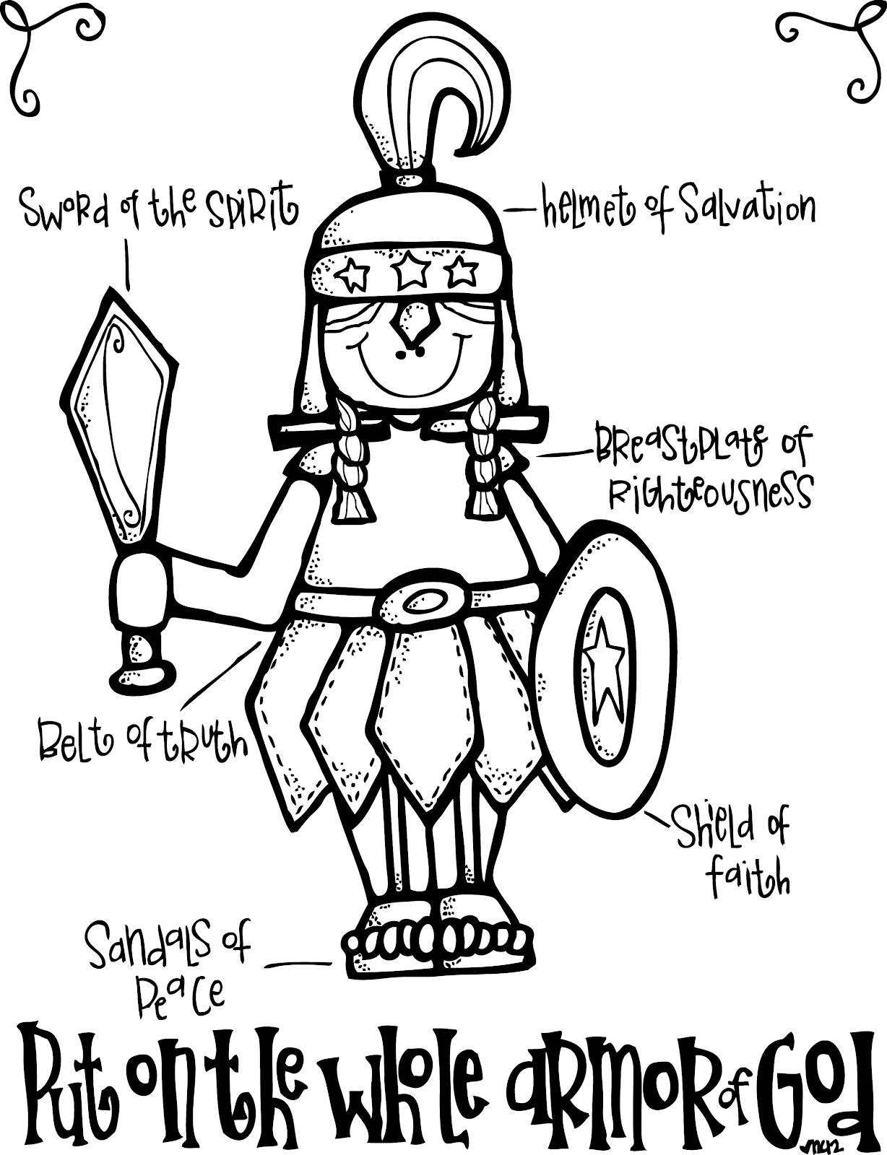
Full Armor of God (Ephesians 6:10-18) )

Slide 11
III. GO to serve our God
Matthew 28:18-20 Then Jesus came to them and said, "All authority in heaven and on earth has been given to me. Therefore GO and make disciples of all nations, baptizing them in the name of the Father and of the Son and of the Holy Spirit, and teaching them to obey everything I have commanded you. And surely I am with you always, to the very end of the age."

Slide 12
The Great Commission
Not “The Great Suggestion”
-It is not an Option, it is God’s Commandment
“A nation will not be moved by timid methods.” - Luis Palau (evangelist)
-what do we need to do to bring transformation?

Slide 13
REFLECTION:
ARE YOU READY?
IS ALL SET FOR THE SPIRITUAL JOURNEY?
WILL YOU GO TO SERVE GOD?

