Slide 1
JAMES 4:17 “Therefore, to him who knows to do good and does not do it, to him it is sin.”

Slide 3
Responsibility Is Very Important
Sin is not only doing wrongful actions.. negligence to do the right thing is considered as a sin also..
Sense of Responsibility is part of Maturity
Our passage will help us rediscover the essence of RESPONSIBILITY..

Slide 4
I. Environmental Responsibility
Genesis 1: 28
God blessed them and said to them, “Be fruitful and increase in number; fill the earth and SUBDUE IT. Rule over the fish in the sea and the birds in the sky and over every living creature that moves on the ground.”

Slide 5
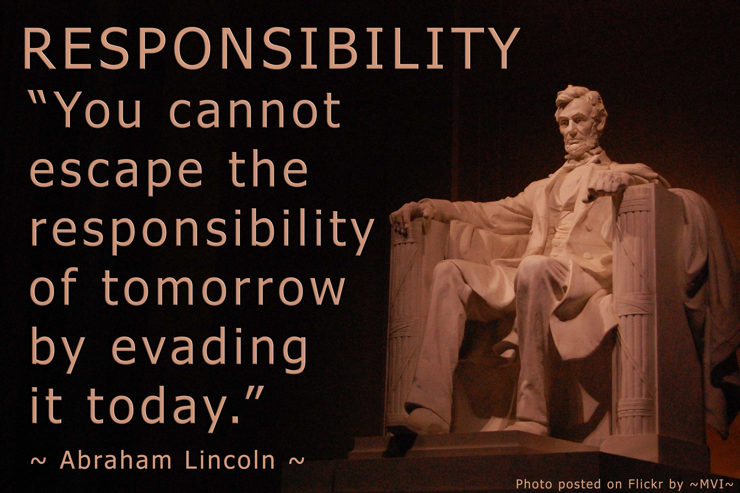
Only one world we are living
Take care of it before its too late
DOMINION should not be perceived as “abuse”
We are to preserve the health of our environment
If we don’t take proper care for our environment we will be the one’s who will suffer also

Slide 6
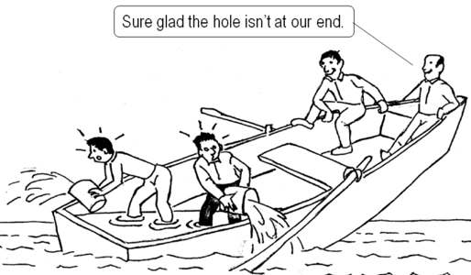
II. Social Responsibility
Galatians 5:14
For the entire law is fulfilled in keeping this one command: "Love your neighbor as yourself.“
-is a borrowed term from the field of business
-businesses will not be successful without the people.. Business owners should help the people also

Slide 7
Church Social Role
It’s different from “pa-sossy” roles
Social Responsibility is a form of duty/service
-Deacon came from the greek word “DIAKONIA”
We should provide Holistic Ministry
-ministry that will not only reach the soul of the people, but also their empty stomachs

Slide 8
III. Spiritual Responsibility
1 Corinthians 3:16
Don't you know that you yourselves are God's temple and that God's Spirit dwells in your midst?
Also called as Spiritual Accountability..
As children of God we are all accountable for our brothers and sisters..
Their spirituality is our accountability..

Slide 9
How can we make our spiritual life healthy?
We must nourish it everyday..
Joshua 1:8
This book of the law shall not depart out of thy mouth; but thou shalt meditate therein day and night, that thou mayest observe to do according to all that is written therein: for then thou shalt make thy way prosperous, and then thou shalt have good success.

Slide 10
Conclusion:
Romans 14:7
For none of us lives for ourselves alone, and none of us dies for ourselves alone.
We don’t exist merely to survive and die..
God gave us life so that we could share it to others also..

