Slide 1
Psalm 100:2 “Worship the LORD with gladness; come before him with joyful songs. “

Slide 3
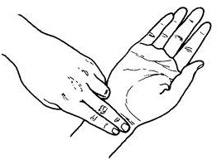
4 Vital Signs
Notes:
4 vital signs are: 1. pulse, 2. heart, 3. respiration, 4. temparature..
But some new research suggest..
5. pain, and 6. spiritual vitality

Slide 4
Vitality a. liveliness -joyous approach to situations b. durability -the ability to live and grow -to continue in existence

Slide 5
To LIVE a godly life
We need Spiritual Vitality
To GROW in ministry
To UNCOVER God’s blessings

Slide 6
I. To LIVE a godly life
John 4:24 “God is spirit, and his worshipers must worship in spirit and in truth.”
“worship in spirit”- malipayon nga pagpangalagad sa atoang Buhi ug Gamhanang Dios
-many have died spiritually because they have no happiness in serving God
-they quit and went back to their old ways
Matthew 13:7 “Other seed fell among thorns, which grew up and choked the plants.”
Notes:
GODLY- makadiyos, living according to God’s will

Slide 7
Mark 9:38 Now John answered Him, saying, “Teacher, we saw someone who does not follow us casting out demons in Your name, and we forbade him because he does not follow us.”
II. To GROW in ministry

Slide 8
II. To GROW in ministry
“At times, it is easier to diminish others’ spiritual victories than to honestly confront our own failures.”
Take a look at the disciples’ hypocrisy
-seem to guard the ministry
-the truth is that they were embarrassed and envious

Slide 9
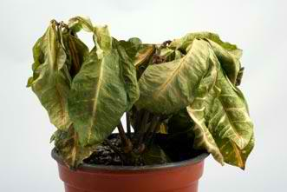
II. To GROW in ministry
Obviously the Disciples were more excited to exhibit “some show”
-that’s why they’re not growing

Slide 10
Proverbs 28:20 The faithful man will prosper with blessings, but whoever is in a hurry to get rich will not escape punishment.
III. To UNCOVER God’s blessings
Luke 9:26
If anyone is ashamed of me and my words, the Son of Man will be ashamed of him when he comes in his glory and in the glory of the Father and of the holy angels.

