Slide 1
1 Corinthians 10:13
“No temptation has overtaken you that is not common to man. God is faithful, and he will not let you be tempted beyond your ability, but with the temptation he will also provide the way of escape, that you may be able to endure it. “

Slide 2
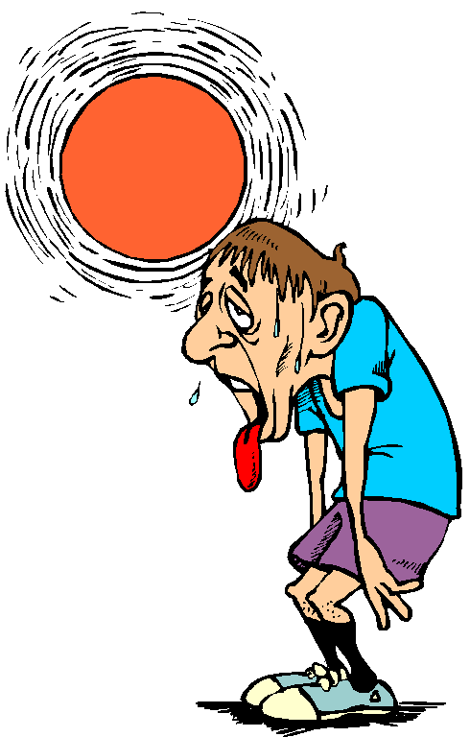
Staying Cool
Under the
Heat of
Pressures

Slide 3
Summer had started
Heat stroke
Init/igang
Beach/resorts
“Malling”
Life is like Summer.. We want to enjoy it but we need to face the “heat”/ spiritual pressures
How do we deal with them?

Slide 4
During Hot Season…
Light colored clothes
Heat protection
Always bring water

Slide 5
During Pressures
Wear a positive outlook
Ask Protection from God
Always bring the Living Water

Slide 6
I. Develop A Positive Outlook
Philippians 4:6
Do not be anxious about anything, but in everything by prayer and supplication with thanksgiving let your requests be made known to God.
-worry serves as fuel to the pressure
-we should testify about God’s goodness by wearing your best smile..
-even if there are others who plot to put you down
Proverbs 15:1
A soft answer turns away wrath, but a harsh word stirs up anger.

Slide 7
“give your best smile always”

Slide 8
II. Ask God’s Protection
2Timothy 4:18 “The Lord will rescue me from every evil deed and bring me safely into his heavenly kingdom. To him be the glory forever and ever. Amen.”
-we should avoid being burn out/ depressed
-if we have problems we should seek refuge in the Lord..
Psalm 46:1 “God is our refuge and strength, a very present help in trouble.”
“Ako ay may sandigan hindi magigiba..”
Psalm 3:3 “But you, LORD, are a shield around me, my glory, the One who lifts my head high.”

Slide 9
III. Always Bring Living Water
John 7:38 He that believes on me, as the scripture has said, out of his heart shall flow rivers of living water.
-it will quench the thirst of those who are thirsty
-your life will become a living testimony
-God wants all of us to become channels of blessings
-we may sometimes ask God how…
Isaiah 35:6
Then will the lame leap like a deer, and the mute tongue shout for joy. Water will gush forth in the wilderness and streams in the desert.

